Slide 1
WELCOME TO LAKE LAGUNA
CASHPOR POVERTY ASSESSMENT
By: Lindsey McDonald

Slide 2
INTRODUCTION
Many organizations will perform a wealth-ranking or poverty assessment before offering services to a community.
Most assessments are based on external factors and usually have a scoring system with the highest numbers reflective of the poorest community members.
Using one of these assessments I will look at a house in Taguig, Manila on Lake Laguna

Slide 3
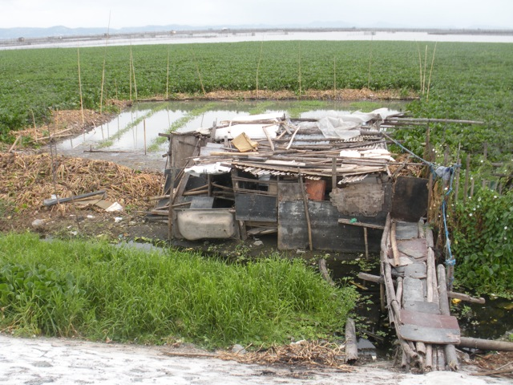
LOCATION/GEOGRAPHY
Located in Manila, Philippines
on Lake Laguna

Slide 4
CASHPOR HOUSING INDEX
CASHPOR is a public charitable trust in Delhi
A Micro Finance Institute
Identify poor household based on height of wall and material used for walls and roof

Slide 5
CASHPOR HOUSING INDEX
Based on belief that income is used for basic necessities and surplus income is used on home improvement

Slide 6
CASHPOR HOUSING INDEX
ASSESSMENT:
1. Height of the Walls and Materials used
- More than 5’ and made of brick = 4
- More than 8’ and made of mud = 2
- Between 4’ and 8’ and made of mud = 1

Slide 7
CASHPOR HOUSING INDEX
ASSESSMENT:
SCORE = 1
(substituting wood/scrap material for mud)

Slide 8
ASSESSMENT:
CASHPOR HOUSING INDEX
2. Materials of Roof
Concrete/Pucca/Patia/New Tiles/
GI Sheet = 2
- Old Tiles/GI Sheet = 1
- Thatch/Straw/Plastic/Leaves = 0

Slide 9
ASSESSMENT:
CASHPOR HOUSING INDEX
SCORE = 0

Slide 10
ASSESSMENT:
CASHPOR HOUSING INDEX
3. MAXIMUM SCORE = 6

Slide 11
ASSESSMENT:
CASHPOR HOUSING INDEX
4. Poverty Status
Non Poor = 4 or more
- Moderately Poor (MP) = 3
- Very Poor (VP) = 2 or less

Slide 12
ASSESSMENT:
CASHPOR HOUSING INDEX
LAKE LAGUNA HOUSE SCORE= 1

Slide 13
ASSESSMENT:
CASHPOR HOUSING INDEX
Conclusion: Very Poor
Eligible for asset interview
Excluding: ownership of a motor vehicle or brick walled houses w/ concrete roof

Slide 14
OTHER RESOURCES:
PANAMA POVERTY ASSESSMENT
Produced by the World Bank in June 1999
http://web.worldbank.org/WBSITE/EXTERNAL/TOPICS/EXTPOVERTY/EXTPA/0,,contentMDK:20207841~menuPK:443285~pagePK:148956~piPK:216618~theSitePK:430367,00.html
3 Objectives:
  To assess extent and determinants of poverty, malnutrition and inequality in Panama
  Examine the impact of gov’t spending and policies on the poor
  Outline priorities and steps for acting on the gov’t approved Poverty Strategy
Used the Living Standards Measurement Survey (LSMS)
Measures a population standard of living whereas other assessments measure an individual’s status

Slide 15
OTHER RESOURCES: POVERTY ASSESSMENT: Pakistan’s Case
http://findarticles.com/p/articles/mi_6788/is_1_34/ai_n28682415/
By M. Shaukat Ali, found in the CBS Interactive Business Network Resource Library
Uses the Extended Linear Expenditure System (ELES) to estimate Total Poverty Line and the “Basic Needs” approach – defining the poverty-line in terms of minimum expenditure on all needs, food and non-food.
Findings of survey revealed ~47% of population had an income less than the threshold expenditure on all needs

Slide 16
OTHER RESOURCES: POVERTY ASSESSMENT: Progress out of Poverty Index
A Grameen Foundation Initiative found at http://www.progressoutofpoverty.org/understanding-the-progress-out-poverty-index
A simple and accurate tool measuring povertly levels of groups and individuals
Country specific based on the individual country’s best representative income and expenditure household survey
Using PPI, MicroFinance Institutes:
  Better define and adhere to their mission
  Increase competitive edge, profitability, client retention responding more quickly and effectively to change
  Provide timely and accurate info to socially responsible investors

